Slide 1
SQL and Postgres Basic Commands
Working from the Command Window, there are a few helpful commands we will need all the time
\l or \list- show the databases in the server
\connect chinook – connects to the database chinook
\dt- show tables in a database
\q- quit
\d {tablename}- show the schema of a table, shows variables+types
After you log on to a database server, use \l to see what databases you have and connect to the one you want to work with. Use \dt to see the tables you have

Slide 2
Selecting Data
The SELECT command in SQL is the primary way we can retrieve (or “pull”) data from a SQL data base.
There are a number of ancillary SQL commands used with SQL to filter data, we can’t do anything at all without the FROM command that specifies the table to use.
The starting syntax for a SELECT command looks like this
SELECT {variables} FROM {tablename}
Where {variables} might be one variable, several variables separated by commas, or a wild card such as * that means “all variables”
See Chapter 3 of “Learning SQL” by Alan Beaulieu

Slide 3
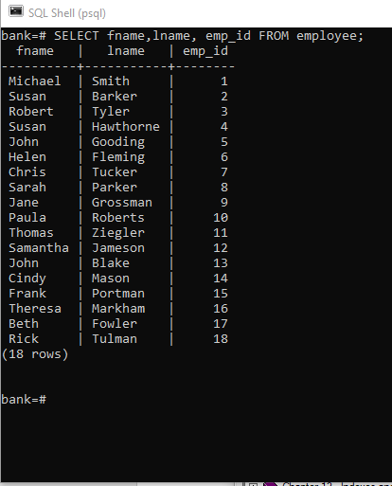
Example- In the command window, type the commands in quotes
1.) use “\connect bank” -to connect to the bank database
2.) use “\dt”- to see all tables
3.) use “\d employee”-to see the schema of the table employee
4.) Now use
“SELECT fname,lname, emp_id FROM employee;”
Capitalize SQL commands
End each line in a semi-colon (:)
Open a command window and try these commands
Specify the variables you want in the start of the SELECT command

Slide 4
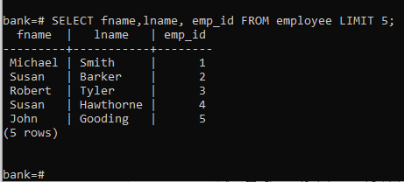
LIMIT
SELECT commands are modified by adding additional terms, much like pipelining commands in the R tidyverse system.
Limit N limits the results to N lines, so it works like a head() operation
Example:
SELECT fname,lname, emp_id FROM employee LIMIT 5;

Slide 5
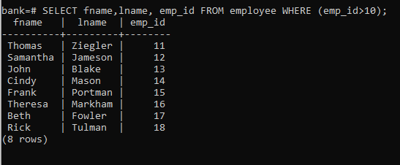
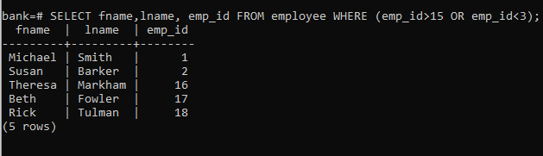
WHERE
The where command limits the rows selected, based on some condition
Example:
SELECT fname,lname, emp_id FROM employee WHERE (emp_id>10);
We can use AND or OR operations inside the WHERE() condition
SELECT fname,lname, emp_id FROM employee WHERE (emp_id>15 OR emp_id<3);
Use WHERE to control the rows selected

Slide 6
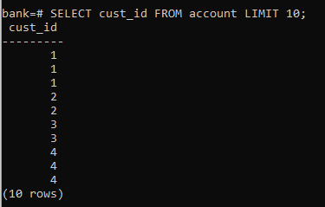
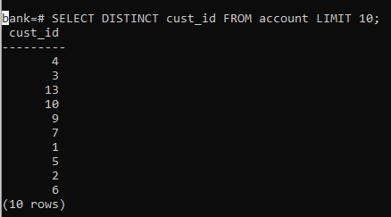
DISTINCT
DISTINCT removes duplicates from a result
SELECT cust_id FROM account; will show duplicates
SELECT DISTINCT cust_id FROM account; removes duplicates

Slide 7
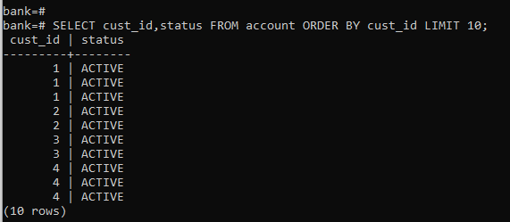
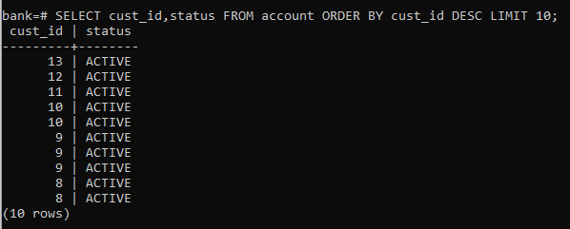
ORDER BY
ORDER BY is a sorting function,
SELECT cust_id,status FROM account ORDER BY cust_id LIMIT 10;
Adding ASC or DESC after the variable name will control the direction of the sorting

Slide 8
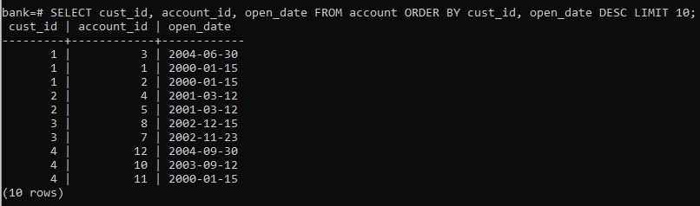
Order by multiple columns
Place all sorting variables on one line, separated by commas, add DESC, ASC as needed
SELECT cust_id, account_id, open_date
FROM account
ORDER BY cust_id, open_date DESC
LIMIT 10;

Slide 9
GROUP BY and HAVING
These are grouping and aggregating operations, with having allowing filtering on grouped data.
See Chapter 8 of “Learning SQL” by Alan Beaulieu

Slide 10
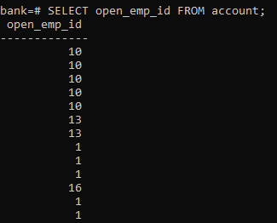
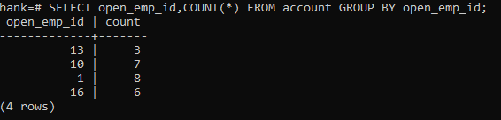
GROUP BY
Allows use to group our results. The default is to provide a count per group.
If we group the account data by open_emp_id, we will want to add a COUNT(*) function to report the count for each open_emp_id value
SELECT open_emp_id,COUNT(*)
FROM account
GROUP BY open_emp_id;
No grouping, just the extracted list of open_emp_id from the accounts table

Slide 11
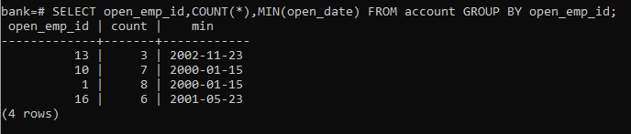
MIN and MAX Functions
Other functions made for use with aggregation are
MAX(), MIN(), AVG(), SUM() and COUNT()
Not surprisingly, SQL has a number of built in functions, including
MIN and MAX
We can add this to the last example, to get the account opening count per employee, but also the minimum (first) date they opened an account, to see if employees with a long history had more account openings
SELECT open_emp_id,COUNT(*),MIN(open_date)
FROM account
GROUP BY open_emp_id;

Slide 12
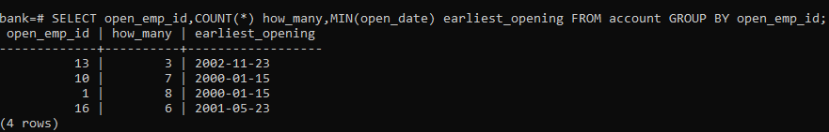
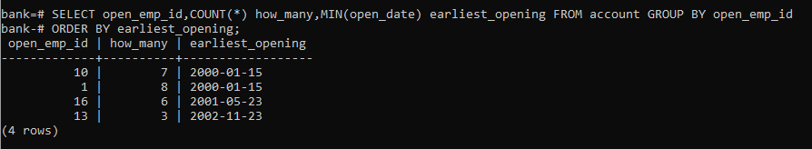
Aliasing
Aliasing is renaming a variable,
We could alias COUNT() to
“how many”
And MIN() to
“earliest opening”
Once MIN(open_date) has an alias, we can sort the data using the Alias- and see that the # of the accounts opened is related to the starting date of the employee

Slide 13
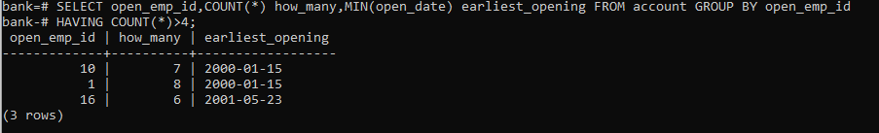
HAVING
HAVING is like a WHERE function for a GROUP BY, allowing us to restrict the grouped output
Example:
SELECT open_emp_id,COUNT(*) how_many,MIN(open_date) earliest_opening
FROM account
GROUP BY open_emp_id
HAVING COUNT(*)>4;

Slide 14
How much processing to do in SQL vs in Python or R?
We will soon see how to pull data from an SQL database and place it in an R or Python dataframe. There is a lot of processing we can do in SQL, in terms of sorting, slicing, ordering and just general data manipulation. We’ll see more of it shortly (joins, subqueries and views).
The question becomes, how much data processing should we do in SQL vs in R or Python.
For really big data sets, where we know we want only a portion of the data (say all orders in Massachusetts in 2022 from a national database that covers many years), then it make sense to do a lot of filtering and selecting in SQL.
But, if the data set is small and we want all or most of it, or we are unsure of what we want, I think it makes more sense to just “slurp it all up”, meaning that we just grab the entire SQL table and drop it into R or Python. We can then do all the data manipulation in R or Python.
SQL queries (and joins in particular) on a large database can take a lot of time and are thus costly. If all the data fits into Python, it may be easier to load it all at once.
Of course, loading a lot of sensitive data from a database onto your local machine may pose security risks, in which case doing as much in SQL as possible could be an advantage.

Slide 15
SELECT now(); - gives the current time and date, useful for time-stamping an operation

